Slide 1
COMP 3400
Week 8 - Friday

Slide 2
Last time
What did we talk about last time?
Finished TCP
Network security
CIA

Slide 3
Questions?

Slide 4
Assignment 5
Form Teams!

Slide 5
Project 2

Slide 6
Cryptography

Slide 7
Cryptography
"Secret writing"
The art of encoding a message so that its meaning is hidden
Cryptanalysis is breaking those codes
Cryptography is a powerful tool for confidentiality because modern encryption methods make it almost impossible to read an encrypted message
Cryptographic hash functions provide a tool for integrity because they can make it obvious when a message has been changed

Slide 8
Cryptography and availability
Although cryptography provides tools for confidentiality and integrity, there's no clear cryptographic tool for availability
In fact, cryptography often makes availability worse because encryption puts more strain on a system
Making it more susceptible to various DoS attacks
There's always tension between confidentiality, integrity, and availability
Increasing confidentiality and integrity usually decreases availability

Slide 9
Encryption and decryption
Encryption is the process of taking a message and encoding it
Decryption is the process of decoding the code back into a message
A plaintext is a message before encryption
A ciphertext is the message in encrypted form
A key is an extra piece of information used in the encryption process

Slide 10
Notation
A plaintext is M (sometimes P)
A ciphertext is C
The encryption function E(x) takes M and converts it into C
E(M) = C
The decryption function D(x) takes C and converts it into M
D(C) = M
We often specify encryption and decryption functions E_{k}(x) and D_{k}(x) specific to a key k

Slide 11
Terminology
A sender S wants to send a message to a recipient R
If S gives the message to T who gives it to R, T is a transmission medium
If an outsider O wants to access the message (to read, change, or destroy it), we call O an interceptor or intruder
The fear is that O will cause one of four security failures:
Blocking the message
Intercepting the message
Modifying the message
Fabricating a false message

Slide 12
Terminology remix
The previous slide gives dry terminology
Rather than use letters, a system popularized by Ron Rivest is to use Alice and Bob as the two parties communicating
Carl or another "C" name can be used if three people are involved
Trent is a trusted third party
Eve is used for an evil user who often eavesdrops
Mallory is used for a malicious user who is usually trying to modify messages

Slide 13
Symmetric key cryptography
Symmetric encryption is what you probably think of as encryption
Two parties have a key which they use for both encrypting and decrypting messages
The key is also known as a shared secret
We have excellent symmetric encryption algorithms, of which AES is the most used
But how do we distribute keys between parties who want to communicate secretly?

Slide 14
AES
Advanced Encryption Standard
Symmetric block cipher designed to replace DES
Block size of 128-bits
Key sizes of 128, 192, and 256 bits
Like the older (and deprecated) DES, has a number of rounds (10, 12, or 14 depending on key size)
Originally called Rijndael, after its Belgian inventors
Competed with 14 other algorithms over a 5 year period before being selected by NIST
No known attacks exist against good implementations of AES
It should take more than a billion billion years to break an AES encryption
Even quantum computers shouldn't change that much

Slide 15
Public Key Cryptography

Slide 16
Public key cryptography
Sometimes, we need something different
We want a public key that anyone can use to encrypt a message to Alice
Alice has a private key that can decrypt such a message
The public key can only encrypt messages; it cannot be used to decrypt messages
Public key cryptography is enormously useful, since companies can publish their public key far and wide
Anyone who wants to send them a secret message can do so
No secret needs to be shared ahead of time

Slide 17
Symmetric vs. public key
Symmetric Key Cryptography
Key K
Plaintext M
Encryption
Ciphertext C
Decryption
Plaintext M
Public Key Cryptography
Encryption Key K_{E}
Decryption Key K_{D}
Plaintext M
Encryption
Ciphertext C
Decryption
Plaintext M

Slide 18
RSA Algorithm
RSA is the most commonly used public key cryptosystem
Named for Rivest, Shamir, and Adleman
Take a plaintext M converted to an integer
Create an ciphertext C as follows:
C = Me mod n
Decrypt C back into M as follows:
M = C^{d} mod n = (Me)^{d} mod n = M^{ed} mod n

Slide 19
Why it's safe
Crazy number theory
For RSA, the modulus n = p·q where p and q are two large (hundreds of digits) primes
It's easy to compute d, the decryption exponent, if you know p and q
No one knows an efficient way to factor a large composite number
However, quantum computers could make RSA much less safe

Slide 20
Cryptographic Hash Functions

Slide 21
Where do passwords go?
What magic happens when you type your password into…
Windows or Unix to log on?
Amazon.com to make a purchase?
A Mandalorian fan site so that you can post on the forums?
A genie from the 8th dimension travels back in time and checks to see what password you originally created

Slide 22
In reality…
The password is checked against a file on a computer
But, how safe is the whole process?
The Mandalorian fan site may not be safe at all
Amazon.com is complicated, much depends on the implementation of public key cryptography
What about your Windows or Unix computer?

Slide 23
Catch-22
Your computer needs to be able read the password file to check passwords
But, even an administrator shouldn't be able to read everyone's passwords
Hash functions to the rescue!

Slide 24
Definition
A cryptographic (or one-way) hash function (also called a cryptographic checksum) takes a variable sized message M and produces a fixed-size hash code H(M)
Not the same as hash functions from data structures
The hash code produced is also called a digest
It can be used to provide authentication of both the integrity and the sender of a message
It allows us to store some information about a message that an attacker cannot use to recover the message

Slide 25
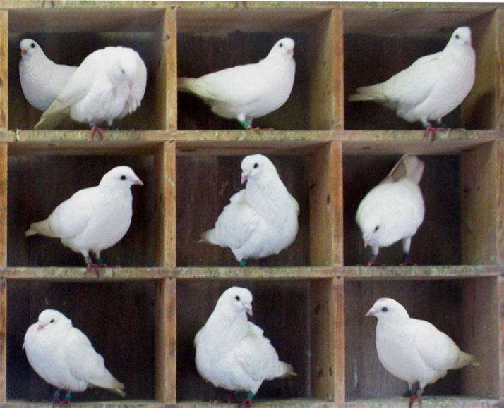
Pigeonhole principle
The pigeonhole principle says that if you try to put m items into n categories, where m > n, then at least 2 things will be in the same category
Imagine that you have a 40,000 byte message and a 256-bit hash digest
How does the pigeonhole principle apply?

Slide 26
Collisions
When two messages hash to the same value, this is called a collision
Because of the pigeonhole principle, collisions are unavoidable
The key feature we want from our hash functions is that collisions are difficult to predict

Slide 27
Crucial properties
Preimage Resistance
Given a digest, should be hard to find a message that would produce it
Collision Resistance
Should be hard to find any two messages that hash to the same digest (collision)
One-way property
Second Preimage Resistance
Given a message m, it should be hard to find a different message that has the same digest

Slide 28
Additional properties
Avalanching
A small change in input should correspond to a large change in output
Speed
It should be fast to compute a digest in software and hardware
Uniformity
Output should be a fixed length
Applicability
Hash function should work on a block of data of any size
No longer than retrieval from secondary storage

Slide 29
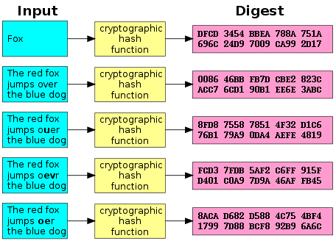
Avalanching in action
Example (from Wikipedia) of significant changes in hash output with small input changes
SHA-1

Slide 30
Password dilemma resolved
Instead of storing the actual passwords, Windows and Unix machines store the hash of the passwords
When someone logs on, the operating system hashes the password and compares it to the stored version
No one gets to see your original password!
Hash functions are also used for digital signatures

Slide 31
MD5
Message Digest Algorithm 5
Popular but outdated hashing algorithm
Designed by Ron Rivest (of RSA fame)
Digest size: 128 bits
Security
Completely broken
Reasonable size attacks (2³²) exist to create two messages with the same hash value
MD5 hashes are still commonly used to check to see if a download finished without error

Slide 32
SHA family
Secure Hash Algorithm
Created by NIST
SHA-0 was published in 1993, but it was replaced in 1995 by SHA-1
The difference between the two is only a single bitwise rotation, but the NSA said it was important
SHA-1 security
Digest size: 160 bits
Considered unsafe
Theoretical attacks can run in 2⁶³ SHA-1 evaluations
SHA-2 is a successor family of hash functions
224, 256, 384, 512 bit digests
Now the preferred hashing function
Designed by the NSA

Slide 33
SHA-3
SHA-3 (Keccak) uses a completely different form of hashing than SHA-0, SHA-1, and SHA-2
Although the attacks on SHA-1 are expensive and there are no real attacks on SHA-2, the attacks on SHA-0 made people nervous about hash functions following the same design
SHA-3 also allows for variable size digests, for added security
224, 256, 384, and 512 are standard
Either SHA-2 or SHA-3 is considered secure (for now)

Slide 34
Upcoming

Slide 35
Next time…
TLS
Internet layer
Link layer
Wireless
Start threads

Slide 36
Reminders
Finish Project 2
Start on Assignment 5
Read sections 5.6, 5.7, 6.1, and 6.2
Have a great break!

